Slide 1
Google Analytics Capstone Project
How does a bike-share navigate speedy success?
By: Victoria Fernández

Slide 2
Roadmap
Cyclistic’s overview
Problematics and Objectives
Datasets and processing
Analysis and insights
Conclusions
Course of action
For further analysis

Slide 3

Cyclistic’s Overview
Cyclistic is a bike-share company in Chicago.
They think the company's future success depends on maximizing the number of annual memberships, so they want to design marketing strategies aimed at converting casual riders into annual members.

Slide 4
Problematics and Objectives
As objectives of our analysis, we want to answer three main questions:
How do annual members and casual riders use Cyclistic bikes differently?
Why would casual riders buy Cyclistic annual memberships?
How can Cyclistic use digital media to influence casual riders to become members?
To do so we will analyse the differences between the two types of riders.

Slide 5
Datasets and processing
The datasets used are .csv files concerning the last year: from June 2022 to June 2023.
They contain data about rider type, dates and hours of departure and arrival and the stations of departure and arrival per trip.
We made use of rider type and the temporal data, since the stations data was incomplete in some cases and not reliable.
The dataset used is public and made available by Motivate International Inc., but the names of the people and company are fictional.

Slide 6
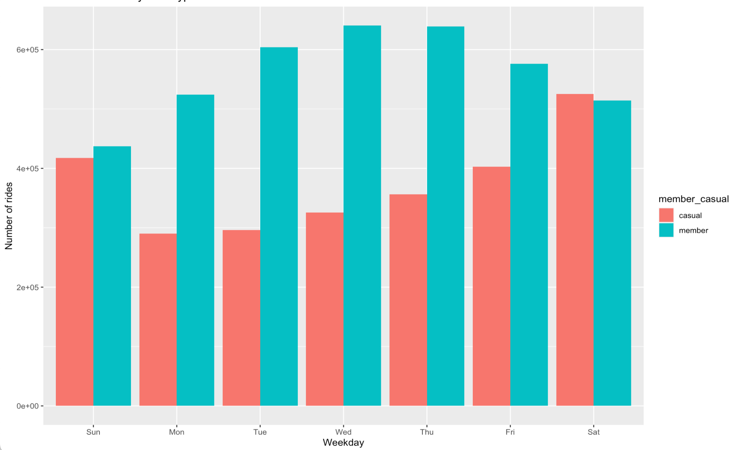
Analysis and insights
Number of rides per day of the week
Wednesday is the most busy day for those who are annual members, but the weekends are the days the casual riders use the service the most.
Rider type
Casual
Member
Number of rides
Weekday

Slide 7
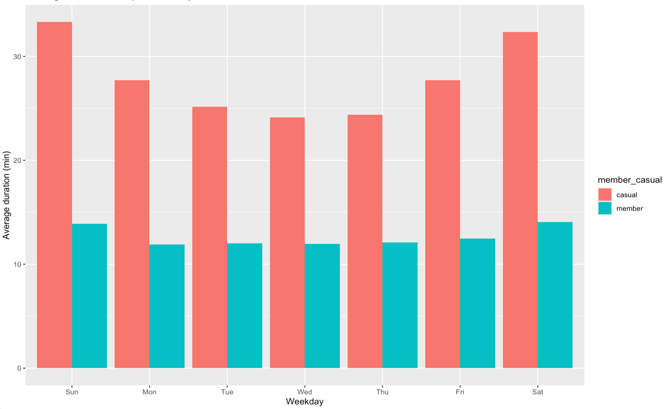
Analysis and insights
Casual riders take longer trips, specially on the weekends.
Average trip duration per day of the week
Average trip duration (min)
Rider type
Casual
Member
Weekday

Slide 8
Conclusions
Main takeaways:
Casual riders use this service for longer rides, specially on the weekends while annual members take shorter rides mostly during the week.
Those with annual subscriptions use the bikes more intensely and also for shorter trips: if they are already paying, why not use the bike?

Slide 9
Conclusions
This may indicate the casual riders commute to work with other kinds of transportation and take rides for leisure on the weekends, or only when the distance is too long and the expense is justifiable.

Slide 10
Course of action
Casual riders can become annual members by realizing that commuting by bike can be more rewarding than other services: it serves as exercise, is eco-friendly, and maybe the price of longer trips adds up faster and becomes more expensive than an annual subscription.

Slide 11
Course of action
Advertising should be tailored to this group focused on this very topics:
how to save money by buying an annual subscription.
how commuting by bike can be beneficial for your body and the planet.

Slide 12
For further analysis
To make a more thorough analysis, some other considerations can be taken into account:
Age groups
Verify if either group rely on other kind of transportation.
A survey can be conducted on this topics and result in a better understatement of our client base.

Slide 13
End of presentation
Thank you for your time

